Slide 1
High School Book Tracking Application
Team:
Aishwarya Anand (A20331867)
Adnan Haider (A20324647)
Umashankar Rajaram (A20391260)
Jagruti Vichare (A20378092)

Slide 2
Technical Snapshot
Programming language: Java
Framework: Spring Boot v2.0.0
Build automation tool: Apache Maven v3.3.9
Database: MySQL v14.14

Slide 3
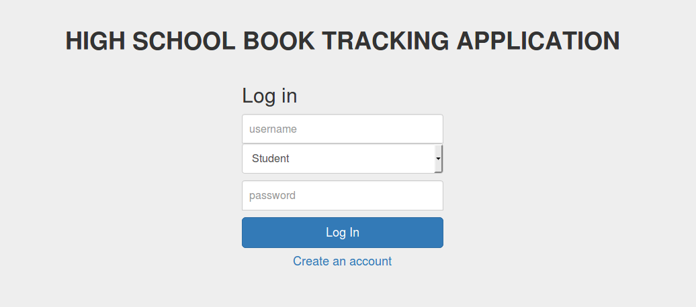
User login

Slide 4
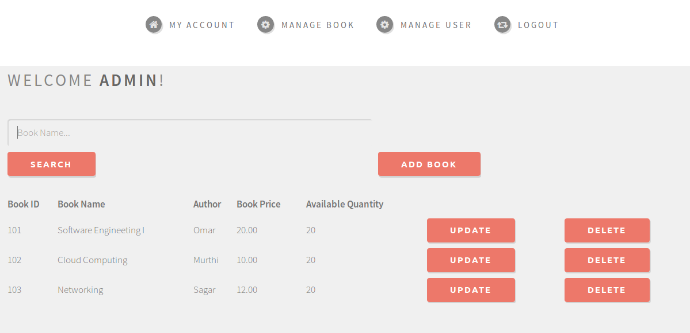
Administrator’s home

Slide 5
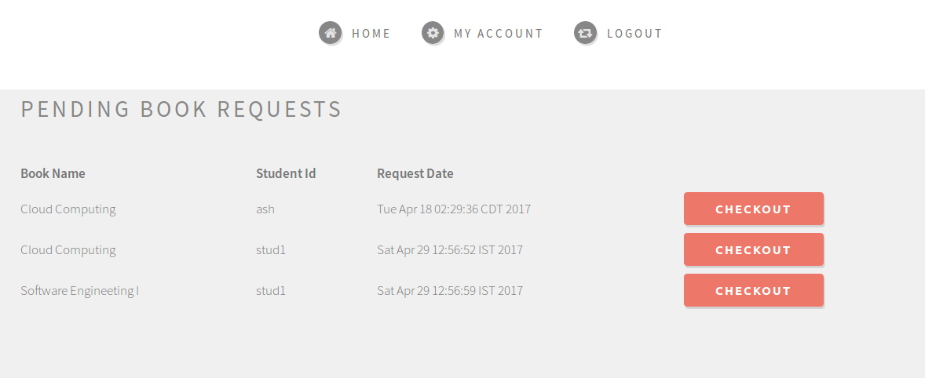
Teacher’s home

Slide 6
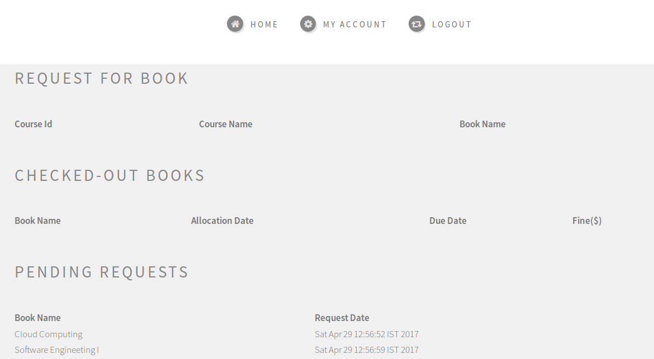
Student’s home

Slide 7
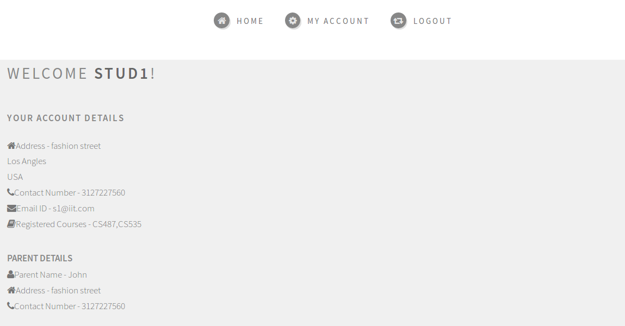
Student’s account

Slide 8
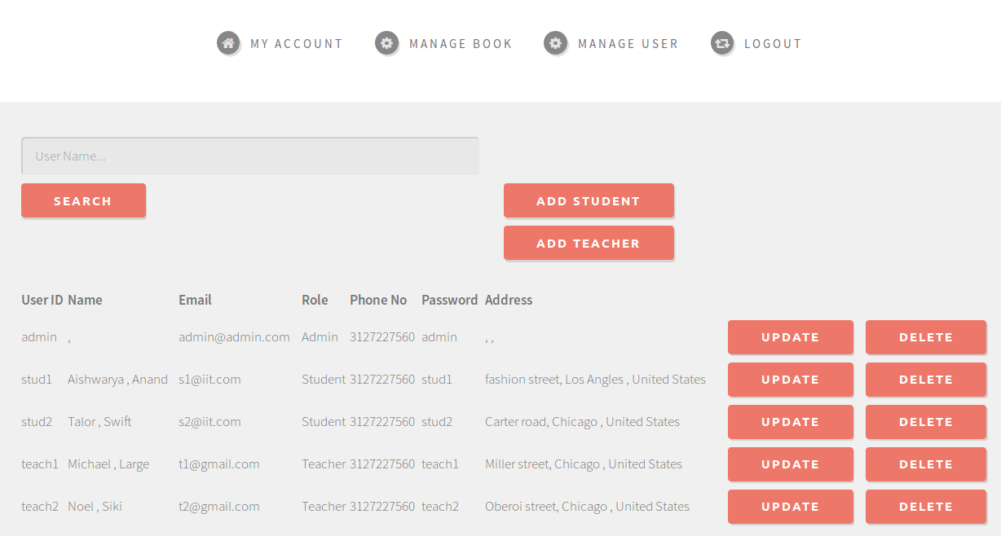
Administrator - User Management

Slide 9
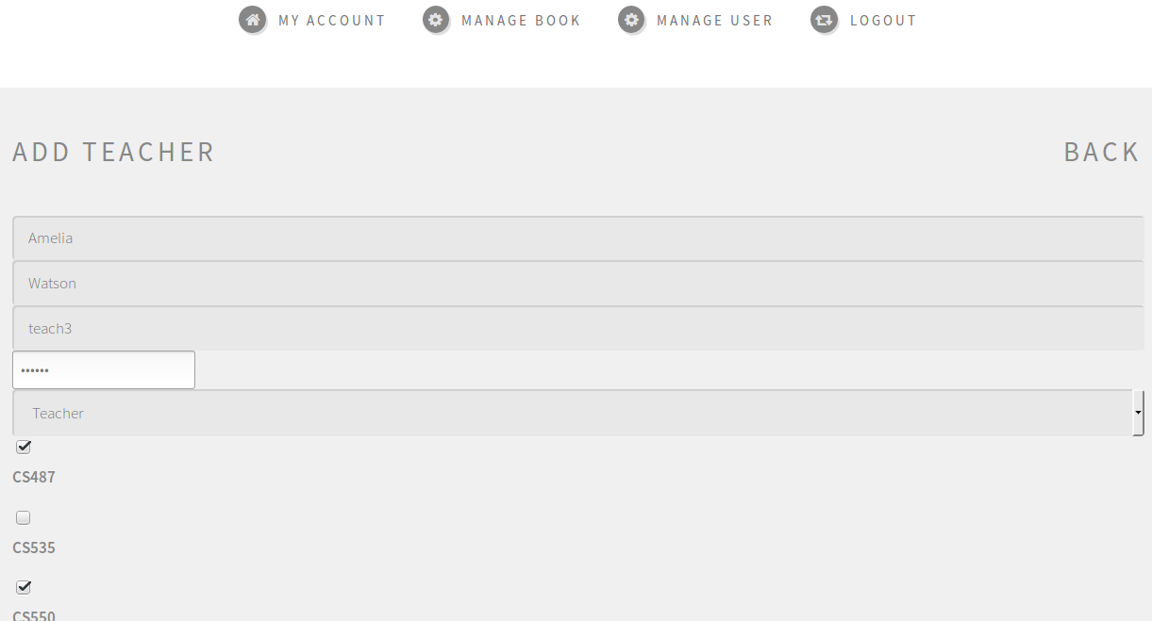
Administrator - Add a Teacher

Slide 10
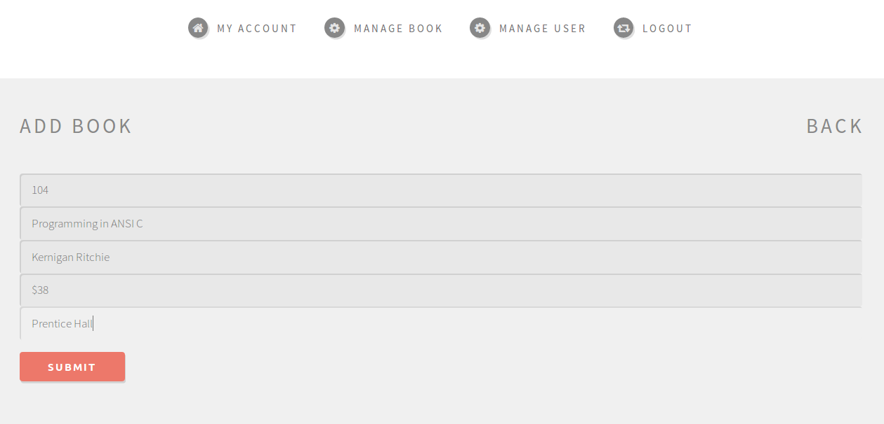
Administrator - Add a Book

Slide 11
Thanks..!

